Slide 1
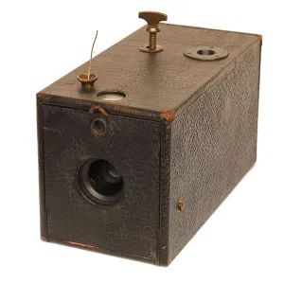
1.1 Fundamental properties of light
A few historical milestones:
In ancient India schools of Samkhya and Vaisheshika (500-600 BC) develop an atomic theory of light and matter
Mo Zi (Mohist school in China about 400 BC) reports on the linear propagation of light, reflection, refraction, camera obscura.
Greek Philosophers (Pythagoras, Democritus, Empedocles, Plato , Aristoteles…) develop first theories of light. There are several wrong concepts, but the rectilinear propagation of light was assessed. The camera obscura is mentioned. A theory of geometrical optics emerges (Euclid, 300 BC, Catoptrics). Later; Hero of Alexandria.
Plato, Aristophanes and later Cleomede and Ptolemy (130 AD) develop the theory of refraction
In the 1st century AD the Romans already developed all kind of lenses (mirrors, glasses)
Under the Islamic hegemony, Alhazen (1000 AD) elaborated the law of reflection. “Modern optics”.
Bacon (1267) developed optical lenses for glasses
Leonardo da Vinci (1502) invents the camera obscura as a tool for painting
Kepler (1611) develops telescope lenses and the law of refraction for small angles (Dioptrics)
1888 Eastman Kodak

Slide 2
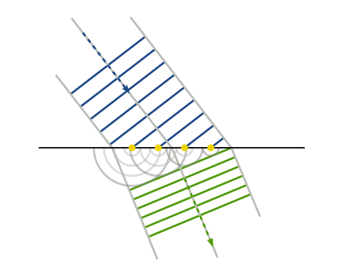
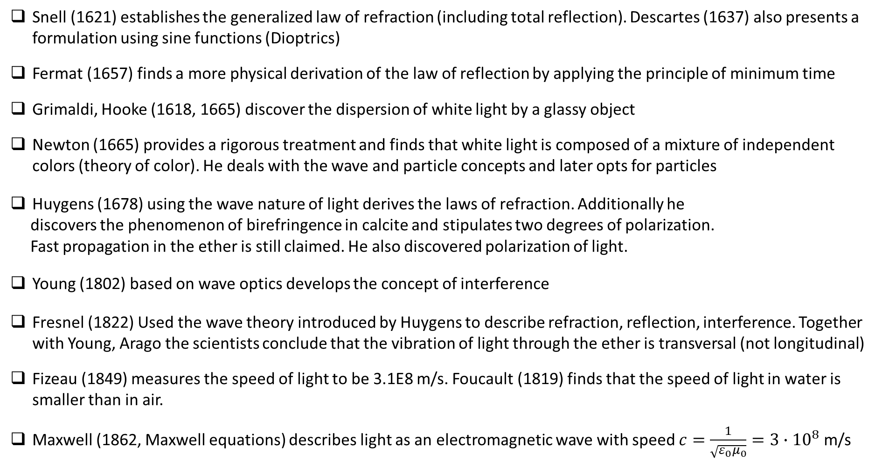
Snell (1621) establishes the generalized law of refraction (including total reflection). Descartes (1637) also presents a formulation using sine functions (Dioptrics)
Fermat (1657) finds a more physical derivation of the law of reflection by applying the principle of minimum time
Grimaldi, Hooke (1618, 1665) discover the dispersion of white light by a glassy object
Newton (1665) provides a rigorous treatment and finds that white light is composed of a mixture of independent colors (theory of color). He deals with the wave and particle concepts and later opts for particles
Huygens (1678) using the wave nature of light derives the laws of refraction. Additionally he
discovers the phenomenon of birefringence in calcite and stipulates two degrees of polarization.
Fast propagation in the ether is still claimed. He also discovered polarization of light.
Young (1802) based on wave optics develops the concept of interference
Fresnel (1822) Used the wave theory introduced by Huygens to describe refraction, reflection, interference. Together with Young, Arago the scientists conclude that the vibration of light through the ether is transversal (not longitudinal)
Fizeau (1849) measures the speed of light to be 3.1E8 m/s. Foucault (1819) finds that the speed of light in water is smaller than in air.
Maxwell (1862, Maxwell equations) describes light as an electromagnetic wave with speed $c=\frac{1}{\sqrt{ε_{0}μ_{0}}}=3∙{10}^{8}$ m/s

Slide 3
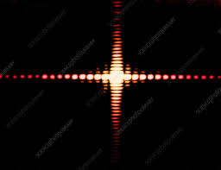
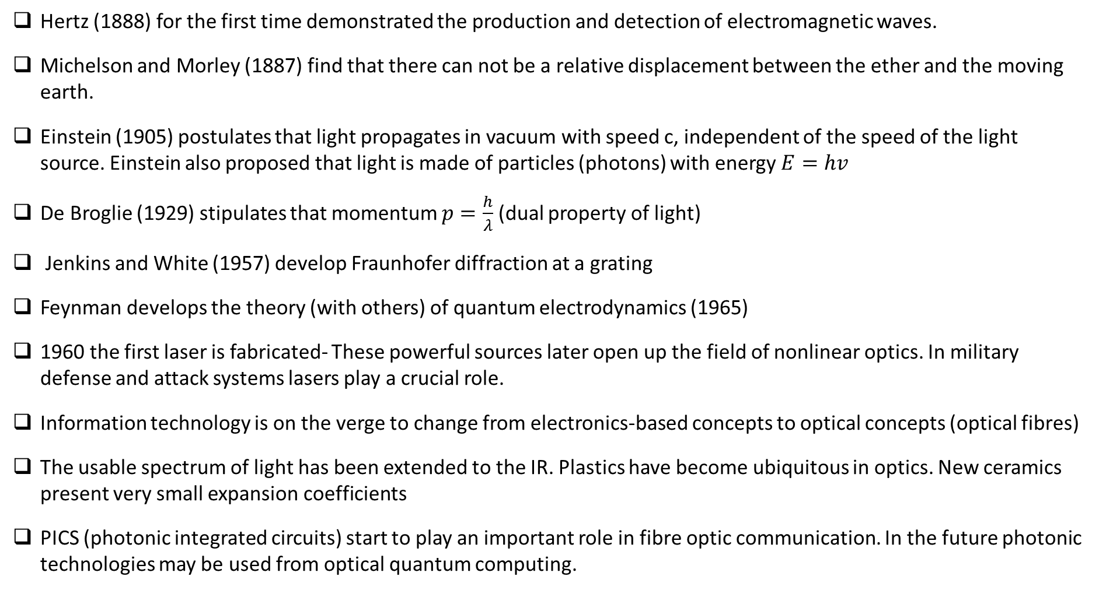
Hertz (1888) for the first time demonstrated the production and detection of electromagnetic waves.
Michelson and Morley (1887) find that there can not be a relative displacement between the ether and the moving earth.
Einstein (1905) postulates that light propagates in vacuum with speed c, independent of the speed of the light source. Einstein also proposed that light is made of particles (photons) with energy $E=hv$
De Broglie (1929) stipulates that momentum $p=\frac{h}{λ}$ (dual property of light)
Jenkins and White (1957) develop Fraunhofer diffraction at a grating
Feynman develops the theory (with others) of quantum electrodynamics (1965)
1960 the first laser is fabricated- These powerful sources later open up the field of nonlinear optics. In military defense and attack systems lasers play a crucial role.
Information technology is on the verge to change from electronics-based concepts to optical concepts (optical fibres)
The usable spectrum of light has been extended to the IR. Plastics have become ubiquitous in optics. New ceramics present very small expansion coefficients
PICS (photonic integrated circuits) start to play an important role in fibre optic communication. In the future photonic technologies may be used from optical quantum computing.

Slide 4







Maxwell’s equations and the optical constants
Maxwell’s equations in continuous media:
Constitutive relations (small fields)
$$\vec{∇}∙\vec{D}=0$$
Gauss’ law (Coulomb, neutral)
(1)
$$\vec{D}=ε_{0}\vec{E}+\vec{P}={ε_{0}\vec{E}+ε_{0}χ_{E}\vec{E}=ε_{0}\left(1+χ_{E}\right)\vec{E}=ε}_{0}ε_{r}\vec{E}$$
Gauss’ law (Magnetic Field)
$$\vec{∇}∙\vec{B}=0$$
(2)
$$\vec{∇}×\vec{H}=\frac{∂\vec{D}}{∂t}+\vec{j}$$
$$\vec{B}=μ_{0}\vec{H}+μ_{0}\vec{M}=μ_{0}\vec{H}+μ_{0}χ_{M}\vec{H}{=μ}_{0}μ_{r}\vec{H}$$
Ampère’s law
(3)
In the linear case (small fields, no ferromagnetic or ferroelectric effects):
$$\vec{∇}×\vec{E}=−\frac{∂\vec{B}}{∂t}$$
Faraday’s law
(4)
$$\vec{j}=σ\vec{E}$$
$$\vec{P}=ε_{0}χ_{E}\vec{E}$$
$$\vec{M}=χ_{M}\vec{H}$$
(5)
Introducing (5) in (1)-(4):

Slide 5

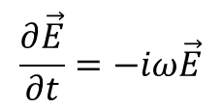

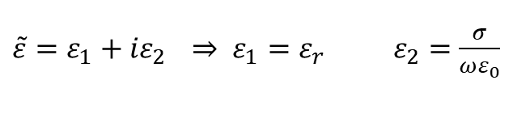

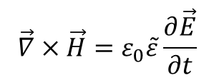

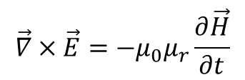

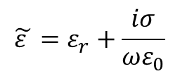



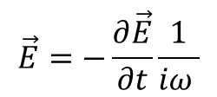
$$\vec{∇}∙\left(ε_{0}\vec{E}+\vec{P}\right)=\vec{∇}∙\vec{E}ε_{0}\left(1+χ_{E}\right)=0$$
$$\vec{∇}∙\vec{E}=0$$
(6)
$$\vec{∇}∙\vec{H}=0$$
(7)
$$\vec{∇}∙\left(μ_{0}\vec{H}+μ_{0}\vec{M}\right)=\vec{∇}∙\vec{H}μ_{0}\left(1+χ_{M}\right)=0$$
$\vec{∇}×\vec{H}=ε_{0}ε_{r}\frac{∂\vec{E}}{∂t}$+$σ\vec{E}$
(8)
$\vec{∇}×\vec{H}=\frac{∂\vec{E}ε_{0}\left(1+χ_{E}\right)}{∂t}+\vec{j}=\frac{∂\vec{E}}{∂t}ε_{0}\left(1+χ_{E}\right)$+$σ\vec{E}$
$$\vec{∇}×\vec{E}=−μ_{0}μ_{r}\frac{∂\vec{H}}{∂t}$$
(9)
$$\vec{∇}×\vec{E}=−μ_{0}\frac{∂}{∂t}\left(\vec{H}+\vec{M}\right)=−μ_{0}\frac{∂\vec{H}}{∂t}(1+χ_{M})$$
Looking for periodic solutions (time dependence $e^{−iωt}$):
using
$$\frac{∂\vec{E}}{∂t}=−iω\vec{E}$$
$$\vec{E}=−\frac{∂\vec{E}}{∂t}\frac{1}{iω }$$
or
$$ε=ε_{0}\left(1+χ_{E}\right)=ε_{0}ε_{r}$$
dielectric function
Using
$$\tilde{ε }=ε_{r}+\frac{iσ}{ωε_{0}}$$
(8) Becomes analogous to (9):
$$μ=μ_{0}\left(1+χ_{M}\right)=μ_{0}μ_{r}$$
permeability
$$\vec{∇}×\vec{H}=ε_{0}\tilde{ε}\frac{∂\vec{E}}{∂t}$$
(8’)
writing
$\tilde{ε}=ε_{1}+{iε}_{2} \underset{⇒}{}$ $ε_{1}=ε_{r} ε_{2}=$ $\frac{σ}{ωε_{0}}$

Slide 6
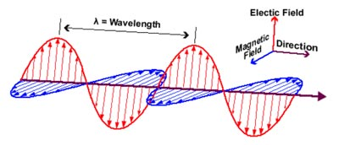




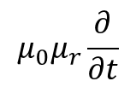
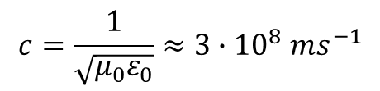

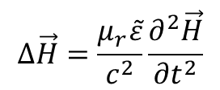

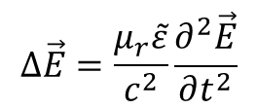


$$μ_{0}μ_{r}\frac{∂}{∂t}$$
Applying
to (8’) and
$$−\vec{∇}×$$
to (9) and using (6):
Note: $\vec{∇}×\vec{∇}$=$\vec{∇}\vec{∇}−∆$
$$∆\vec{E}=\frac{μ_{r}\tilde{ε}}{c^{2}}\frac{∂^{2}\vec{E}}{∂t^{2}}$$
$$∆\vec{H}=\frac{μ_{r}\tilde{ε}}{c^{2}}\frac{∂^{2}\vec{H}}{∂t^{2}}$$
(10)
and similarly
(11)
with
$$c=\frac{1}{\sqrt{μ_{0}ε_{0}}}≈3∙{10}^{8} ms^{−1}$$
(vacuum)
A solution for (10) is given by:
$$\vec{E}={\vec{E}}_{0}e^{i(\vec{𝓀}\vec{r}−ωt)}$$
and similarly for (11):
$\vec{H}={\vec{H}}_{0}e^{i(\vec{𝓀}\vec{r}−ωt)}$ with ${\vec{𝓀}}^{2}=\frac{μ_{r}\tilde{ε}}{c^{2}}ω^{2}$
Applying solutions (11) to (6) and (7) we obtain:
$$\vec{𝓀}\vec{E}=\vec{𝓀}\vec{H}=0$$
i.e. electric and magentic fields are perpendicular to the wavevector
Inserting $\vec{E}={\vec{E}}_{0}e^{i(\vec{𝓀}\vec{r}−ωt)}$ and $\vec{H}={\vec{H}}_{0}e^{i(\vec{𝓀}\vec{r}−ωt)}$ in (9) we get:
$$\vec{𝓀}×{\vec{E}}_{0}=μ_{0}μ_{r}{ω\vec{H}}_{0}$$
and similarly when inserting the solutions of the wave equ. Into (8’):
$$\vec{𝓀}$$
$$\vec{𝓀}×{\vec{H}}_{0}={ε_{0}\tilde{ε}ω\vec{E}}_{0}$$

Slide 7
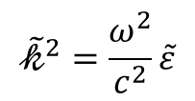

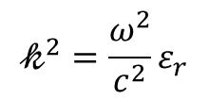








From (10) we see that the speed of light in a non-absorbing solid is :
c’$=\frac{c}{\sqrt{μ_{r}ε_{r}}}≈\frac{c}{\sqrt{ε_{r}}}$
non magnetic solids.
$$n=\sqrt{ε_{r}}$$
is the real refractive index
Inserting solution of the in $\vec{E}={\vec{E}}_{0}e^{i(\vec{k}\vec{r}−ωt)}$one obtains :
$$𝓀^{2}=\frac{ω^{2}}{c^{2}}ε_{r}$$
$$𝓀=\frac{ω}{c}n$$
or
In absorbing media, we can proceed in analogy (non-magnetic solids $μ_{r}=1$)
$${\tilde{𝓀}}^{2}=\frac{ω^{2}}{c^{2}}\tilde{ε}$$
and one can define a complex refractive index such that
$$\tilde{ε}={\tilde{n} }^{2}={\left(n+ik\right)}^{2}$$
(12)
It follows from $\tilde{ε}=ε_{1}+iε_{2}$
that
$$ε_{1}=n^{2}−k^{2}$$
and
$$ε_{2}=2nk$$
As can be seen by inserting
(12)
into
$$\vec{E}={\vec{E}}_{0}e^{i(\vec{𝓀}\vec{r}−ωt)}$$
the electromagnetic wave is damped:
$$\vec{E}\sim {\vec{E}}_{0}e^{−\frac{ω}{c}kz}$$
For a wave propagating in z-direction
(13)

Slide 8
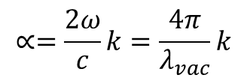
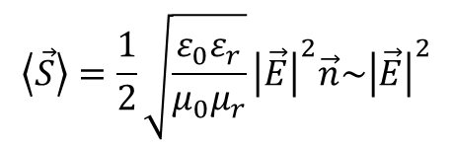



Power flux density is given by the pointing vector S:
$$\left\langle \vec{S}\right\rangle =\frac{1}{2}\sqrt{\frac{ε_{0}ε_{r}}{μ_{0}μ_{r}}}{\left|\vec{E}\right|}^{2}\vec{n}\sim {\left|\vec{E}\right|}^{2}$$
$$\vec{S}= (\vec{E}×\vec{H})$$
and it can be shown that the time average is:
(14)
Using (13) we can therefore :
$$I\sim {\left|{\vec{E}}_{0}e^{− \frac{ω}{c}kd}\right|}^{2}\sim e^{−∝d}$$
$$∝=\frac{2ω}{c}k=\frac{4π}{λ_{vac}}k$$
and therefore
(15)
For the attenuation of a light beam of intensity $I_{0}$ we can therefore write:
$${I=I}_{0}e^{−∝d}$$
$∝$ is the absorption coefficient (in cm⁻¹) and d is the thickness of the sample

Slide 9
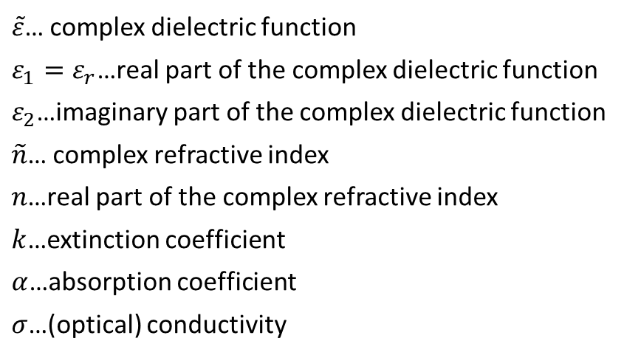

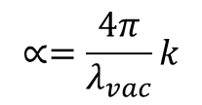




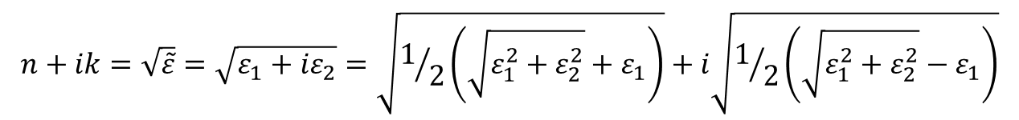

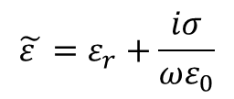
Optical constants and complex dielectric function (depend on frequency, temperature):
$$\tilde{ε}=ε_{1}+iε_{2}$$
$$\tilde{n}=n+ik$$
with
$$\tilde{ε}={\tilde{n}}^{2}$$
$$ε_{1}=n^{2}−k^{2}$$
$$ε_{2}=2nk$$
$$\tilde{ε }=ε_{r}+\frac{iσ}{ωε_{0}}$$
$$∝=\frac{4π}{λ_{vac}}k$$
Sometimes: $k$ is $κ$
$$n+ik=\sqrt{\tilde{ε}}=\sqrt{ε_{1}+{iε}_{2}}=\sqrt{1/2\left(\sqrt{ε_{1}^{2}+ε_{2}^{2}}+ε_{1}\right)}+i\sqrt{1/2\left(\sqrt{ε_{1}^{2}+ε_{2}^{2}}−ε_{1}\right)}$$
$\tilde{ε}$… complex dielectric function
$ε_{1}=ε_{r}$…real part of the complex dielectric function
$ε_{2}$…imaginary part of the complex dielectric function
$\tilde{n}$… complex refractive index
$n$…real part of the complex refractive index
$k$…extinction coefficient
$α$…absorption coefficient
$σ$…(optical) conductivity

Slide 10
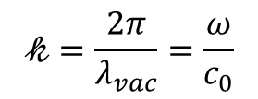



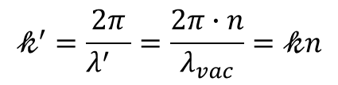
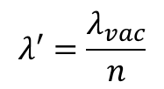
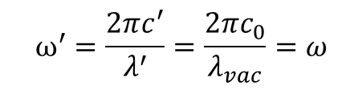
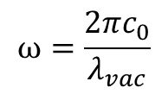
Properties of electromagnetic waves in vacuum and in condensed media:
$$\vec{𝓀}$$
$n$is the refractive index
In vacuum:
In condensed media (‘):
$$𝓀=\frac{2π}{λ_{vac}}=\frac{ω}{c_{0}}$$
$$c′=\frac{c_{0}}{n}$$
$$ω^{′}=\frac{2πc^{′}}{λ^{′}}=\frac{2πc_{0}}{λ_{vac}}=ω$$
$$ω=\frac{{2πc}_{0}}{λ_{vac}}$$
$$λ′=\frac{λ_{vac}}{n}$$
$$𝓀^{′}=\frac{2π}{{λ^{′}}_{}}=\frac{2π∙n}{λ_{vac}}=𝓀n$$

Slide 11
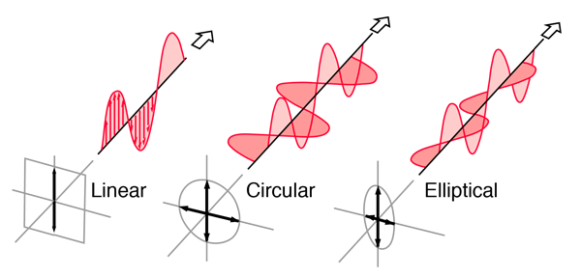




Polarization of electromagnetic waves (we just look at the electric field here):
$$λ$$
$$\vec{𝓀}$$
$$\vec{𝓀}$$
$$\vec{𝓀}$$

Slide 12
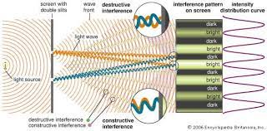
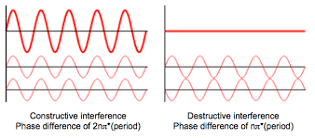
Interference of coherent light beams

